Slide 1
Searching

Slide 2
Searching:
Searching is the fundamental process of locating a specific element or item within a collection of data. This collection of data can take various forms, such as arrays, lists, trees, or other structured representations.
Following two type Searching:
Linear Search
Binary Search

Slide 3
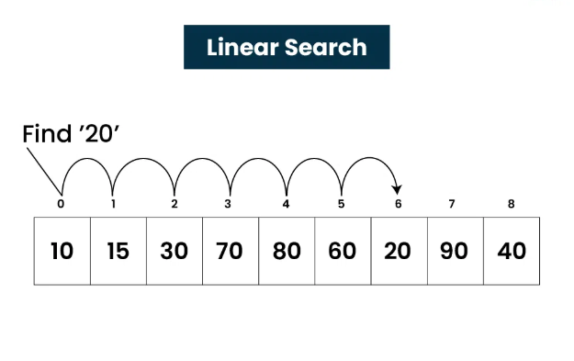
1. Linear Search:
Linear Search, also known as Sequential Search, is one of the simplest and most straightforward searching algorithms. It works by sequentially examining each element in a collection of data(array or list) until a match is found or the entire collection has been traversed.

Slide 4
Algorithm of Linear Search:
The Algorithm examines each element, one by one, in the collection, treating each element as a potential match for the key you're searching for.
If it finds any element that is exactly the same as the key you're looking for, the search is successful, and it returns the index of key.
If it goes through all the elements and none of them matches the key, then that means "No match is Found".

Slide 5
#include <iostream>
Using namespace std;
int search(int arr[], int N, int x)
{
for (int i = 0; i < N; i++)
if (arr[i] == x)
return i;
return -1;
}
int main()
{ int arr[] = { 2, 3, 4, 10, 40 };
int x = 10;
int N = sizeof(arr) / sizeof(arr[0]);
// Function call
int result = search(arr, N, x);
(result == -1)
printf("Element is not present in array");
printf("Element is present at index %d", result);
return 0;
}
Output: Present at index at 3

Slide 6
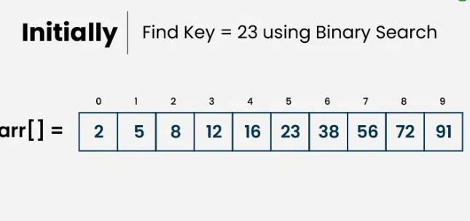
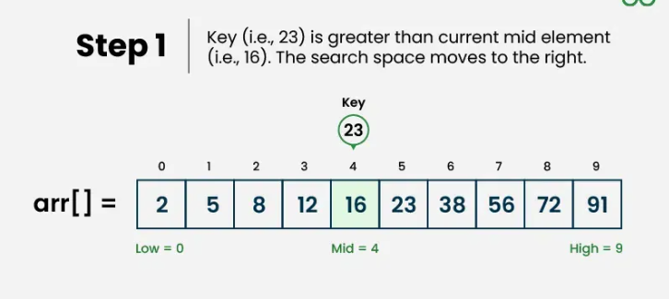
Binary Search :
Binary Search Algorithm is a searching algorithm used in a sorted array by repeatedly dividing the search interval in half. The idea of binary search is to use the information that the array is sorted and reduce the time complexity.

Slide 7
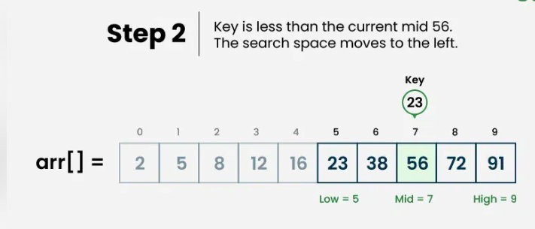
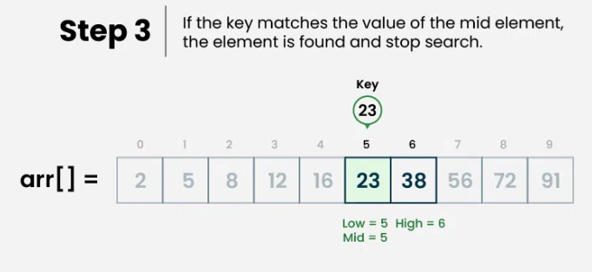

Slide 8
Binary Search Algorithm:
Divide the search space into two halves by finding the middle index “mid”.
Compare the middle element of the search space with the key.
If the key is found at middle element, the process is terminated.
If the key is not found at middle element, choose which half will be used as the next search space.
  If the key is smaller than the middle element, then the left side is used for next search.
  If the key is larger than the middle element, then the right side is used for next search.
This process is continued until the key is found or the total search space is exhausted

Slide 9
// C program to implement iterative Binary Search
#include <iostream>
Using namespace std;
// An iterative binary search function.
int binarySearch(int arr[], int low, int high, int x)
{
while (low <= high) {
int mid = low + (high - low) / 2;
// Check if x is present at mid
if (arr[mid] == x)
return mid;
// If x greater, ignore left half
if (arr[mid] < x)
low = mid + 1;
// If x is smaller, ignore right half
else
high = mid - 1;
}
// If we reach here, then element was not present
return -1;
}

Slide 10
// Driver code
int main(void)
{
int arr[] = { 2, 3, 4, 10, 40 };
int n = sizeof(arr) / sizeof(arr[0]);
int x = 10;
int result = binarySearch(arr, 0, n - 1, x);
if(result == -1) printf("Element is not present in array");
else printf("Element is present at index %d",result);
}

Slide 11
THANK YOU…!!

