Slide 1
Unit II
Control Flow and Loops
Presentation By – S.S.Kagale
Assistant Professor VCK

Slide 2
Conditional Statements
A conditional statement is used to handle conditions in your program. These statements guide the program while making decisions based on the conditions encountered by the program.
Like every other programming language, Python also has some predefined conditional statements. A conditional statement as the name suggests itself, is used to handle conditions in your program. These statements guide the program while making decisions based on the conditions encountered by the program.
Conditional Statements
if statement
if-else statement
if-elif-else ladder
Indentation in Python
For the ease of programming and to achieve simplicity, python doesn't allow the use of parentheses for the block level code. In Python, indentation is used to declare a block. If two statements are at the same indentation level, then they are the part of the same block.
Indentation is the most used part of the python language since it declares the block of code. All the statements of one block are intended at the same level indentation. We will see how the actual indentation takes place in decision making and other stuff in python.

Slide 3
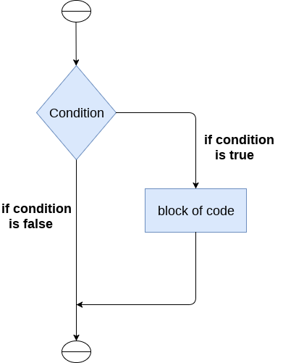
.
The if statement
The if statement is used to test a particular condition and if the condition is true, it executes a block of code known as if-block. The condition of if statement can be any valid logical expression which can be either evaluated to true or false.

Slide 4
The syntax of the if-statement is given below.
if expression:
statement
Example 1
# Simple Python program to understand the if statement
num = int(input("enter the number:"))
# Here, we are taking an integer num and taking input dynamically
if num%2 == 0:
# Here, we are checking the condition. If the condition is true, we will enter the block
print("The Given number is an even number")

Slide 5
Example 2 : Program to print the largest of the three numbers.
# Simple Python Program to print the largest of the three numbers.
a = int (input("Enter a: "));
b = int (input("Enter b: "));
c = int (input("Enter c: "));
if a>b and a>c:
# Here, we are checking the condition. If the condition is true, we will enter the block
print ("From the above three numbers given a is largest");
if b>a and b>c:
# Here, we are checking the condition. If the condition is true, we will enter the block
print ("From the above three numbers given b is largest");
if c>a and c>b:
# Here, we are checking the condition. If the condition is true, we will enter the block
print ("From the above three numbers given c is largest");

Slide 6
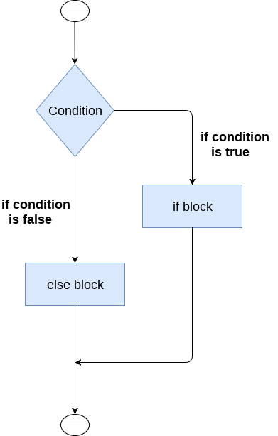
.
The if-else statement
The if-else statement provides an else block combined with the if statement which is executed in the false case of the condition.

Slide 7
The syntax of the if-else statement is given below.
if condition:
#block of statements
else:
#another block of statements (else-block)
Example 1 : Program to check whether a person is eligible to vote or not.
# Simple Python Program to check whether a person is eligible to vote or not.
age = int (input("Enter your age: "))
# Here, we are taking an integer num and taking input dynamically
if age>=18:
# Here, we are checking the condition. If the condition is true, we will enter the block
print("You are eligible to vote !!");
else:
print("Sorry! you have to wait !!");

Slide 8
Example 2: Program to check whether a number is even or not.
# Simple Python Program to check whether a number is even or not.
num = int(input("enter the number:"))
# Here, we are taking an integer num and taking input dynamically
if num%2 == 0:
# Here, we are checking the condition. If the condition is true, we will enter the block
print("The Given number is an even number")
else:
print("The Given Number is an odd number")

Slide 9
The elif statement
The elif statement enables us to check multiple conditions and execute the specific block of statements depending upon the true condition among them. We can have any number of elif statements in our program depending upon our need. However, using elif is optional.
The elif statement works like an if-else-if ladder statement in C. It must be succeeded by an if statement.
The syntax of the elif statement is given below.
if expression 1:
# block of statements
elif expression 2:
# block of statements
elif expression 3:
# block of statements
else:
# block of statements

Slide 10
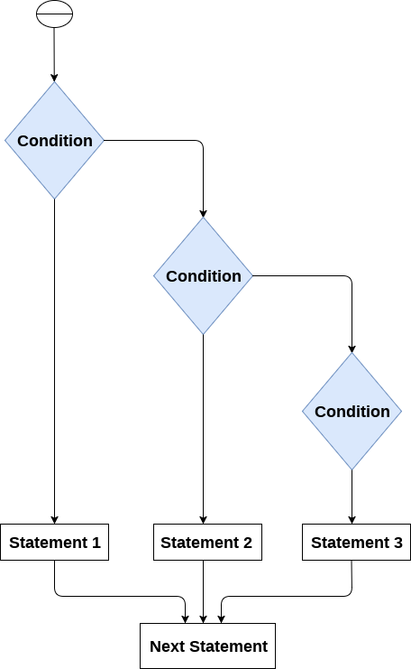

Slide 11
Example 1
# Simple Python program to understand elif statement
number = int(input("Enter the number?"))
# Here, we are taking an integer number and taking input dynamically
if number==10:
# Here, we are checking the condition. If the condition is true, we will enter the block
print("The given number is equals to 10")
elif number==50:
# Here, we are checking the condition. If the condition is true, we will enter the block
print("The given number is equal to 50");
elif number==100:
# Here, we are checking the condition. If the condition is true, we will enter the block
print("The given number is equal to 100");
else:
print("The given number is not equal to 10, 50 or 100");

Slide 12
Loops
The following loops are available in Python to fulfil the looping needs. Python offers 3 choices for running the loops. The basic functionality of all the techniques is the same, although the syntax and the amount of time required for checking the condition differ.
We can run a single statement or set of statements repeatedly using a loop command.
The following loops are available in the Python programming language.
While loop
For loop
Nested loop
While Loop
While loops are used in Python to iterate until a specified condition is met. However, the statement in the program that follows the while loop is executed once the condition changes to false.
Syntax of the while loop is:
while <condition>:
{ code block }

Slide 13
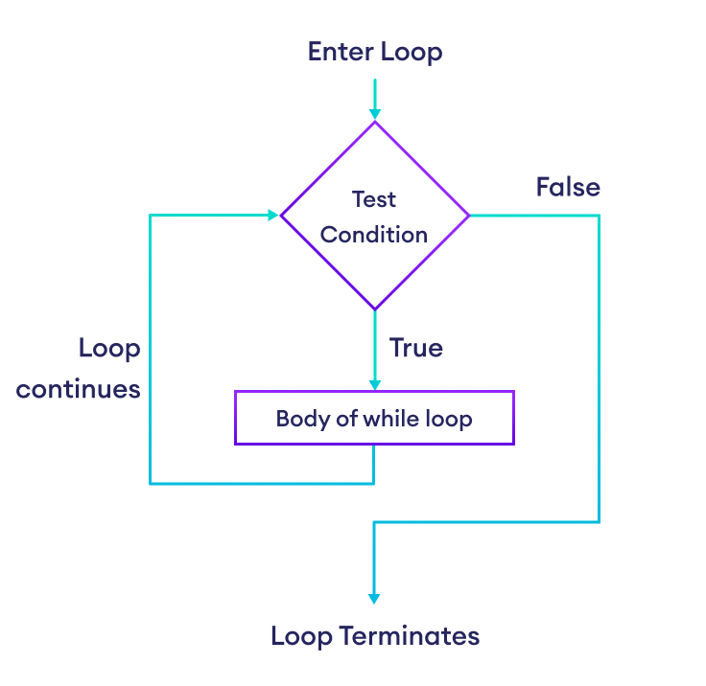

Slide 14
Here,
The while loop evaluates the condition.
If the condition is true, body of while loop is executed. The condition is evaluated again.
This process continues until the condition is False.
Once the condition evaluates to False, the loop terminates.
number = 1
while number <= 3:
print(number)
number = number + 1
Output
1 2 3
In the above example, we have used a while loop to print the numbers from 1 to 3. The loop runs as long as the condition number <= 3 is satisfied.
# Python program to show how to use a while loop
counter = 0
# Initiating the loop
while counter < 10: # giving the condition
counter = counter + 3
print("Python Loops")

Slide 15
# Calculate the sum of numbers until user enters 0
number = int(input('Enter a number: '))
total = 0
# iterate until the user enters 0
while number != 0:
total += number
number = int(input('Enter a number: '))
print('The sum is', total)

Slide 16
for Loop
Python's for loop is designed to repeatedly execute a code block while iterating through a list, tuple, dictionary, or other iterable objects of Python. The process of traversing a sequence is known as iteration.
Syntax of the for Loop
for value in sequence:
{ code block }
In this case, the variable value is used to hold the value of every item present in the sequence before the iteration begins until this particular iteration is completed.
Loop iterates until the final item of the sequence are reached.
languages = ['Swift', 'Python', 'Go']
# access elements of the list one by one
for i in languages:
print(i)
Output
Swift Python GoIn the above example, we have created a list called languages. As the list has 3 elements, the loop iterates 3 times.
The value of i is
Swift in the first iteration.
Python in the second iteration.
Go in the third iteration.

Slide 17
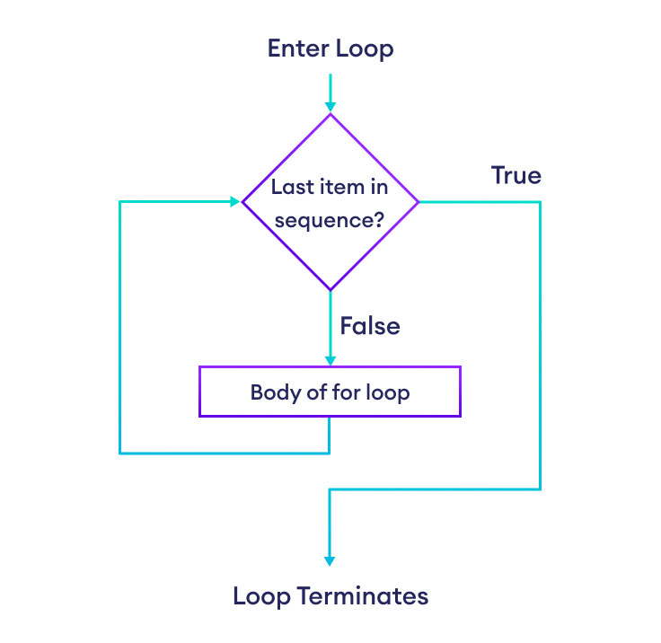

Slide 18
Example: Loop Through a String
language = 'Python'
# iterate over each character in language
for x in language:
print(x)
Output
P
y
t
h
o
N
Here, we have printed each character of the string language using a for loop.

Slide 19
for Loop with Python range()
In Python, the range() function returns a sequence of numbers. For example,
values = range(4)Here, range(4) returns a sequence of 0, 1, 2 ,and 3.
Since the range() function returns a sequence of numbers, we can iterate over it using a for loop. For example,
# iterate from i = 0 to i = 3
for i in range(4):
print(i)
Output
0
1
2
3

