Slide 1
Unit IV
PL/SQL

Slide 2
Introduction
PL/SQL (Procedural Language/Structured Query Language) is a block-structured language developed by Oracle that allows developers to combine the power of SQL with procedural programming constructs. The PL/SQL language enables efficient data manipulation and control-flow logic, all within the Oracle Database.
In this article, we’ll cover PL/SQL basics, including its core features, PL/SQL block structure, and practical examples that demonstrate the power of PL/SQL. We’ll also explore the differences between SQL and PL/SQL, how variables and identifiers work, and how the PL/SQL execution environment operates within Oracle.
Basics of PL/SQL
PL/SQL stands for Procedural Language extensions to the Structured Query Language (SQL).
PL/SQL is a combination of SQL along with the procedural features of programming languages.
Oracle uses a PL/SQL engine to process the PL/SQL statements.
PL/SQL includes procedural language elements like conditions and loops. It allows declaration of constants and variables, procedures and functions, types and variable of those types and triggers.

Slide 3
Features of PL/SQL
PL/SQL is basically a procedural language, which provides the functionality of decision-making, iteration, and many more features of procedural programming languages.
PL/SQL can execute a number of queries in one block using single command.
One can create a PL/SQL unit such as procedures, functions, packages, triggers, and types, which are stored in the database for reuse by applications.
PL/SQL provides a feature to handle the exception which occurs in PL/SQL block known as exception handling block.
Applications written in PL/SQL are portable to computer hardware or operating system where Oracle is operational.
PL/SQL Offers extensive error checking.

Slide 4
Differences Between SQL and PL/SQL
SQL | PL/SQL
SQL is a single query that is used to perform DML and DDL operations. | PL/SQL is a block of codes that used to write the entire program blocks/ procedure/ function, etc.
It is declarative, that defines what needs to be done, rather than how things need to be done. | PL/SQL is procedural that defines how the things needs to be done.
Execute as a single statement. | Execute as a whole block.
Mainly used to manipulate data. | Mainly used to create an application.
Cannot contain PL/SQL code in it. | It is an extension of SQL, so it can contain SQL inside it.

Slide 5
Structure of PL/SQL Block
PL/SQL extends SQL by adding constructs found in procedural languages, resulting in a structural language that is more powerful than SQL. The basic unit in PL/SQL is a block. All PL/SQL programs are made up of blocks, which can be nested within each other.
Typically, each block performs a logical action in the program. A block has the following structure:
DECLARE
declaration statements;
BEGIN
executable statements
EXCEPTIONS exception handling statements
END;
Declare section starts with DECLARE keyword in which variables, constants, records as cursors can be declared which stores data temporarily. It basically consists definition of PL/SQL identifiers. This part of the code is optional.
Execution section starts with BEGIN and ends with END keyword.This is a mandatory section and here the program logic is written to perform any task like loops and conditional statements. It supports all DML commands, DDL commands and SQL*PLUS built-in functions as well.
Exception section starts with EXCEPTION keyword.This section is optional which contains statements that are executed when a run-time error occurs. Any exceptions can be handled in this section.

Slide 6
PL/SQL Identifiers
There are several PL/SQL identifiers such as variables, constants, procedures, cursors, triggers etc.
Variables: Like several other programming languages, variables in PL/SQL must be declared prior to its use. They should have a valid name and data type as well.
Syntax for declaration of variables:
variable_name datatype [NOT NULL := value ];
Example to show how to declare variables in PL/SQL :
SQL> SET SERVEROUTPUT ON;
SQL> DECLARE
var1 INTEGER;
var2 REAL;
var3 varchar2(20) ;
BEGIN null; END; /
Output:
PL/SQL procedure successfully completed.

Slide 7
Explanation:
  SET SERVEROUTPUT ON: It is used to display the buffer used by the dbms_output.
  var1 INTEGER : It is the declaration of variable, named var1 which is of integer type. There are many other data types that can be used like float, int, real, smallint, long etc. It also supports variables used in SQL as well like NUMBER(prec, scale), varchar, varchar2 etc.
  PL/SQL procedure successfully completed.: It is displayed when the code is compiled and executed successfully.
  Slash (/) after END;: The slash (/) tells the SQL*Plus to execute the block.
  Assignment operator (:=) : It is used to assign a value to a variable.

Slide 8
Displaying Output: The outputs are displayed by using DBMS_OUTPUT which is a built-in package that enables the user to display output, debugging information, and send messages from PL/SQL blocks, subprograms, packages, and triggers.
Example:
SQL> SET SERVEROUTPUT ON;
SQL> DECLARE
var varchar2(40) := ‘Welcome to PL/SQL' ;
BEGIN dbms_output.put_line(var);
END;
/
Output:
Welcome to PL/SQL
PL/SQL procedure successfully completed.
Explanation:
  dbms_output.put_line : This command is used to direct the PL/SQL output to a screen.
Using Comments: Like in many other programming languages, in PL/SQL also, comments can be put within the code which has no effect in the code. There are two syntaxes to create comments in PL/SQL :
  Single Line Comment: To create a single line comment , the symbol – – is used.
  Multi Line Comment: To create comments that span over several lines, the symbol /* and */ is used.

Slide 9
Taking input from user: Just like in other programming languages, in PL/SQL also, we can take input from the user and store it in a variable. Let us see an example to show how to take input from users in PL/SQL:
SQL> SET SERVEROUTPUT ON;
SQL> DECLARE
-- taking input for variable a
a number := &amp;a;
-- taking input for variable b
b varchar2(30) := &amp;b;
BEGIN
null;
END;
/

Slide 10
Output:
Enter value for a: 24
old 2: a number := &a;
new 2: a number := 24;
Enter value for b: ‘Welcome To PL/SQL'
old 3: b varchar2(30) := &b;
new 3: b varchar2(30) := Welcome To PL/SQL ';
PL/SQL procedure successfully completed.

Slide 11
--PL/SQL code to print sum of two numbers taken from the user.
SQL> SET SERVEROUTPUT ON;
SQL> DECLARE
-- taking input for variable a
a integer := &a ;
-- taking input for variable b
b integer := &b ;
c integer ;
BEGIN c := a + b ;
dbms_output.put_line('Sum of '||a||' and '||b||' is = '||c);
END;
/
Output
Enter value for a: 2
Enter value for b: 3
Sum of 2 and 3 is = 5
PL/SQL procedure successfully completed.

Slide 12
Datatypes
S.No | Category & Description
1 | Scalar Single values with no internal components, such as a NUMBER, DATE, or BOOLEAN.
2 | Large Object (LOB) Pointers to large objects that are stored separately from other data items, such as text, graphic images, video clips, and sound waveforms.
3 | Composite Data items that have internal components that can be accessed individually. For example, collections and records.
4 | Reference Pointers to other data items.

Slide 13
Scalar Data Types and Subtypes
PL/SQL Scalar Data Types and Subtypes come under the following categories −
S.No | Date Type & Description
1 | Numeric Numeric values on which arithmetic operations are performed.
2 | Character Alphanumeric values that represent single characters or strings of characters.
3 | Boolean Logical values on which logical operations are performed.
4 | Datetime Dates and times.
PL/SQL provides subtypes of data types. For example, the data type NUMBER has a subtype called INTEGER. You can use the subtypes in your PL/SQL program to make the data types compatible with data types in other programs while embedding the PL/SQL code in another program, such as a Java program.

Slide 14
PL/SQL Numeric Data Types and Subtypes
Following table lists out the PL/SQL pre-defined numeric data types and their sub-types
S.No | Data Type & Description
1 | PLS_INTEGER Signed integer in range -2,147,483,648 through 2,147,483,647, represented in 32 bits
2 | BINARY_INTEGER Signed integer in range -2,147,483,648 through 2,147,483,647, represented in 32 bits
3 | BINARY_FLOAT Single-precision IEEE 754-format floating-point number
4 | BINARY_DOUBLE Double-precision IEEE 754-format floating-point number
5 | NUMBER(prec, scale) Fixed-point or floating-point number with absolute value in range 1E-130 to (but not including) 1.0E126. A NUMBER variable can also represent 0
6 | DEC(prec, scale) ANSI specific fixed-point type with maximum precision of 38 decimal digits
7 | DECIMAL(prec, scale) IBM specific fixed-point type with maximum precision of 38 decimal digits
8 | NUMERIC(pre, secale) Floating type with maximum precision of 38 decimal digits
9 | DOUBLE PRECISION ANSI specific floating-point type with maximum precision of 126 binary digits (approximately 38 decimal digits)
10 | FLOAT ANSI and IBM specific floating-point type with maximum precision of 126 binary digits (approximately 38 decimal digits)
11 | INT ANSI specific integer type with maximum precision of 38 decimal digits
12 | INTEGER ANSI and IBM specific integer type with maximum precision of 38 decimal digits
13 | SMALLINT ANSI and IBM specific integer type with maximum precision of 38 decimal digits
14 | REAL Floating-point type with maximum precision of 63 binary digits (approximately 18 decimal digits)

Slide 15
Following is a valid declaration −
DECLARE
num1 INTEGER;
num2 REAL;
num3 DOUBLE PRECISION;
BEGIN
null;
END;
/
When the above code is compiled and executed, it produces the following result −
PL/SQL procedure successfully completed

Slide 16
PL/SQL Character Data Types and Subtypes
Following is the detail of PL/SQL pre-defined character data types and their sub-types −
S.No | Data Type & Description
1 | CHAR Fixed-length character string with maximum size of 32,767 bytes
2 | VARCHAR2 Variable-length character string with maximum size of 32,767 bytes
3 | RAW Variable-length binary or byte string with maximum size of 32,767 bytes, not interpreted by PL/SQL
4 | NCHAR Fixed-length national character string with maximum size of 32,767 bytes
5 | NVARCHAR2 Variable-length national character string with maximum size of 32,767 bytes
6 | LONG Variable-length character string with maximum size of 32,760 bytes
7 | LONG RAW Variable-length binary or byte string with maximum size of 32,760 bytes, not interpreted by PL/SQL
8 | ROWID Physical row identifier, the address of a row in an ordinary table
9 | UROWID Universal row identifier (physical, logical, or foreign row identifier)

Slide 17
PL/SQL Datetime and Interval Types
The DATE datatype is used to store fixed-length datetimes, which include the time of day in seconds since midnight. Valid dates range from January 1, 4712 BC to December 31, 9999 AD.
The default date format is set by the Oracle initialization parameter NLS_DATE_FORMAT. For example, the default might be 'DD-MON-YY', which includes a two-digit number for the day of the month, an abbreviation of the month name, and the last two digits of the year. For example, 01-OCT-12.
Each DATE includes the century, year, month, day, hour, minute, and second. The following table shows the valid values for each field −
Field Name | Valid Datetime Values | Valid Interval Values
YEAR | -4712 to 9999 (excluding year 0) | Any nonzero integer
MONTH | 01 to 12 | 0 to 11
DAY | 01 to 31 (limited by the values of MONTH and YEAR, according to the rules of the calendar for the locale) | Any nonzero integer
HOUR | 00 to 23 | 0 to 23
MINUTE | 00 to 59 | 0 to 59
SECOND | 00 to 59.9(n), where 9(n) is the precision of time fractional seconds | 0 to 59.9(n), where 9(n) is the precision of interval fractional seconds
TIMEZONE_HOUR | -12 to 14 (range accommodates daylight savings time changes) | Not applicable
TIMEZONE_MINUTE | 00 to 59 | Not applicable
TIMEZONE_REGION | Found in the dynamic performance view V$TIMEZONE_NAMES | Not applicable
TIMEZONE_ABBR | Found in the dynamic performance view V$TIMEZONE_NAMES | Not applicable

Slide 18
PL/SQL (Procedural Language/Structured Query Language) is Oracle’s extension to SQL that allows for procedural programming within databases. It features various conditional statements to control the flow of execution based on specific conditions.
PL/SQL Conditional Statements
PL/SQL (Procedural Language/Structured Query Language) is an extension of SQL used in Oracle databases to write procedural code. It includes various conditional statements that allow developers to execute different blocks of code based on specific conditions. Decision-making statements in programming languages decide the direction of the flow of program execution. Conditional Statements available in PL/SQL are defined below:
IF THEN
IF THEN ELSE
NESTED-IF-THEN
IF THEN ELSIF-THEN-ELSE Ladder
1. IF THEN
if then the statement is the most simple decision-making statement. It is used to decide whether a certain statement or block of statements will be executed or not i.e if a certain condition is true then a block of statement is executed otherwise not.
Syntax:
if condition then
-- do something
end if;
Here, condition after evaluation will be either true or false. if statement accepts boolean values – if the value is true then it will execute the block of statements below it otherwise not. if and endif consider as a block here.

Slide 19
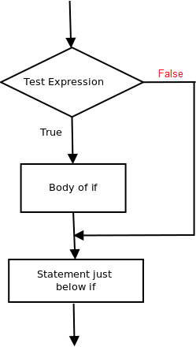
Example:
declare
-- declare the values here
begin
if condition then
dbms_output.put_line('output');
end if;
dbms_output.put_line('output2');
end;

Slide 20
-- pl/sql program to illustrate If statement
declare
num1 number:= 10;
num2 number:= 20;
begin
if num1 > num2 then
dbms_output.put_line('num1 small');
end if;
dbms_output.put_line('I am Not in if');
end;
As the condition present in the if statement is false. So, the block below the if statement is not executed.
Output:
I am Not in if

Slide 21
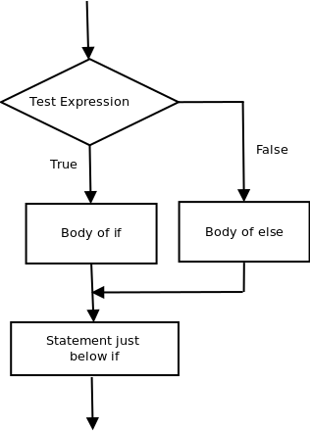
2. IF THEN ELSE
The if statement alone tells us that if a condition is true it will execute a block of statements and if the condition is false it won’t. But what if we want to do something else if the condition is false. Here comes the else statement. We can use the else statement with if statement to execute a block of code when the condition is false.
Syntax:-
if (condition) then
-- Executes this block if
-- condition is true
else
-- Executes this block if
-- condition is false

Slide 22
-- pl/sql program to illustrate If else statement
declare
num1 number:= 10;
num2 number:= 20;
begin
if num1 < num2 then
dbms_output.put_line('i am in if block');
ELSE
dbms_output.put_line('i am in else Block');
end if;
dbms_output.put_line('i am not in if or else Block');
end;
Output:-
i'm in if Block
i'm not in if and not in else Block
The block of code following the else statement is executed as the condition present in the if statement is false after calling the statement which is not in block(without spaces).

Slide 23
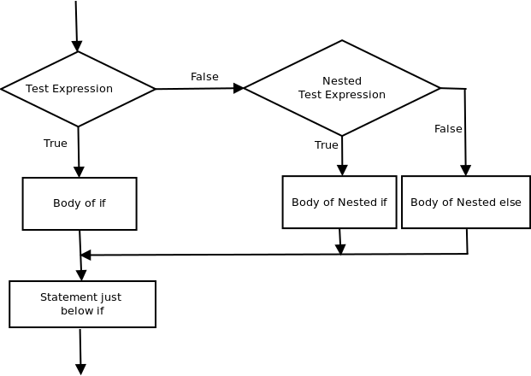
3. NESTED-IF-THEN
A nested if-then is an if statement that is the target of another if statement. Nested if-then statements mean an if statement inside another if statement. Yes, PL/SQL allows us to nest if statements within if-then statements. i.e, we can place an if then statement inside another if then statement. Syntax:-
if (condition1) then
-- Executes when condition1 is true
if (condition2) then
-- Executes when condition2 is true
end if;
end if;

Slide 24
-- pl/sql program to illustrate nested If statement
declare
num1 number:= 10;
num2 number:= 20;
num3 number:= 20;
begin if num1 < num2 then
dbms_output.put_line('num1 small num2');
if num1 < num3 then
dbms_output.put_line('num1 small num3 also');
end if;
end if;
dbms_output.put_line('after end if');
end;
Output:-
num1 small num2
num1 small num3 also
after end if

Slide 25
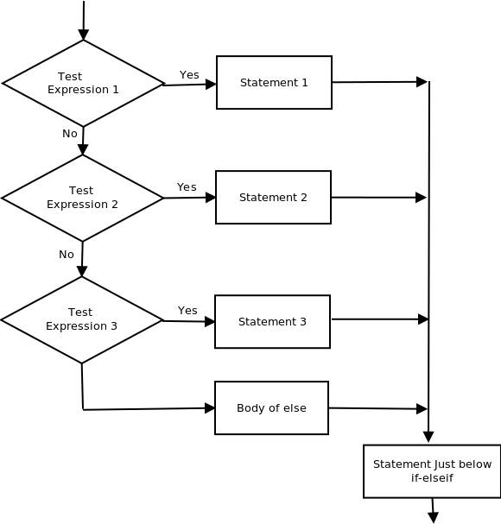
4. IF THEN ELSIF-THEN-ELSE Ladder
Here, a user can decide among multiple options. The if then statements are executed from the top down. As soon as one of the conditions controlling the if is true, the statement associated with that if is executed, and the rest of the ladder is bypassed. If none of the conditions is true, then the final else statement will be executed. Syntax:-
if (condition) then
--statement
elsif (condition) then
--statement
.
.
else
--statement
endif

Slide 26
Example:-
-- pl/sql program to illustrate if-then-elif-then-else ladder
declare
num1 number:= 10;
num2 number:= 20;
begin if num1 < num2 then
dbms_output.put_line('num1 small');
ELSEIF num1 = num2 then
dbms_output.put_line('both equal');
ELSE
dbms_output.put_line('num2 greater');
end if;
dbms_output.put_line('after end if');
end;
Output:-
num1 small
after end if

Slide 27
One of the key features in PL/SQL for controlling program flow is the LOOP statement. The LOOP statement is a feature of PL/SQL that allows you to repeatedly execute a block of code until a specified condition is satisfied.
Procedural Language/Structured Query Language (PL/SQL) provides a robust environment for database programming, allowing developers to create powerful and efficient code for Oracle databases.
• Simple Loop
• While Loop
• For Loop
1) Simple Loop
A Simple Loop is used when a set of statements is to be executed at least once before the loop terminates. An EXIT condition must be specified in the loop, otherwise the loop will get into an infinite number of iterations. When the EXIT condition is satisfied the process exits from the loop.
General Syntax to write a Simple Loop is
:
LOOP
statements;
EXIT;
{or EXIT WHEN condition;}
END LOOP;

Slide 28
These are the important steps to be followed while using Simple Loop.
1) Initialise a variable before the loop body.
2) Increment the variable in the loop.
3) Use a EXIT WHEN statement to exit from the Loop. If you use a EXIT statement without WHEN condition, the statements in the loop is executed only once.
DECLARE
counter NUMBER := 1;
BEGIN
LOOP DBMS_OUTPUT.PUT_LINE('This is iteration number ' || counter);
IF counter = 3 THEN
EXIT;
END IF;
counter := counter + 1;
END LOOP;
END; /
Output:
Statement processed.
This is iteration number 1 T
his is iteration number 2
This is iteration number 3

Slide 29
DECLARE
counter NUMBER := 1;
-- Initialization of the counter variable
BEGIN
-- Loop that prints “PLSQL" five times LOOP
DBMS_OUTPUT.PUT_LINE(PLSQL ');
counter := counter + 1;
-- Increment the counter
EXIT WHEN counter > 5;
-- Exit the loop when counter exceeds 5
END LOOP;
END;
/
Output:
Statement processed.
PLSQL
PLSQL
PLSQL
PLSQL
PLSQL

Slide 30
2) While Loop
A WHILE LOOP is used when a set of statements has to be executed as long as a condition is true. The condition is evaluated at the beginning of each iteration. The iteration continues until the condition becomes false.
The General Syntax to write a WHILE LOOP is:
WHILE <condition> LOOP
statements;
END LOOP;
Important steps to follow when executing a while loop:
1) Initialise a variable before the loop body.
2) Increment the variable in the loop.
3) EXIT WHEN statement and EXIT statements can be used in while loops but it's not done oftenly.
DECLARE
i INTEGER := 1;
BEGIN
WHILE i <= 10 LOOP
DBMS_OUTPUT.PUT_LINE(i);
i := i+1;
END LOOP;
END;
Explanation: On execution the above code, the value of i will be incremented by 1 every time it enters the loop and exits when i < =10.
Output:
After the execution of the above code, you will get the following result:
1
2
3
4
5
6
7
8
9
10

Slide 31
DECLARE
N NUMBER: = 1;
BEGIN
WHILE N <= 8
LOOP
DBMS_OUTPUT.PUT_LINE (‘Loop executes ‘ || N || ‘ times’);
N: = N + 1;
EXIT WHEN N >6
END LOOP;
END;
Explanation: On executing the above code, the value of N will be incremented by 1 every time it enters the loop and exits when N >6. Here this condition is indicated with the EXIT WHEN statement.
Output:
Loop executes 1 times
Loop executes 2 times
Loop executes 3 times
Loop executes 4 times
Loop executes 5 times

Slide 32
3) FOR Loop
A FOR LOOP is used to execute a set of statements for a predetermined number of times. Iteration occurs between the start and end integer values given. The counter is always incremented by 1. The loop exits when the counter reachs the value of the end integer.
The General Syntax to write a FOR LOOP is:
FOR counter IN val1..val2
LOOP statements;
END LOOP;
val1 - Start integer value.
val2 - End integer value.
Important steps to follow when executing a while loop:
1) The counter variable is implicitly declared in the declaration section, so it's not necessary to declare it explicity.
2) The counter variable is incremented by 1 and does not need to be incremented explicitly.
3) EXIT WHEN statement and EXIT statements can be used in FOR loops but it's not done oftenly.

Slide 33
BEGIN
FOR k IN 1..10 LOOP
-- note that k was not declared
DBMS_OUTPUT.PUT_LINE(k);
END LOOP;
END;
Explanation: On execution the above code, the value of k will be incremented by 1 every time it enters the loop and exits when k < =10.
Output:
1
2
3
4
5
6
7
8
9
10

Slide 34
Example 2
DECLARE
VAR1 NUMBER;
BEGIN
VAR1:=10;
FOR VAR2 IN 1..10
LOOP
DBMS_OUTPUT.PUT_LINE (VAR1*VAR2);
END LOOP;
END;
Output
10
20
30
40
50
60
70
80
90
100

Slide 35
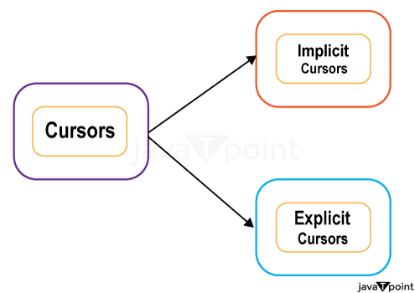
Cursor
When an SQL statement is processed, Oracle creates a memory area known as context area. A cursor is a pointer to this context area. It contains all information needed for processing the statement. In PL/SQL, the context area is controlled by Cursor. A cursor contains information on a select statement and the rows of data accessed by it.
A cursor is used to referred to a program to fetch and process the rows returned by the SQL statement, one at a time. There are two types of cursors:
Implicit Cursors
Explicit Cursors

Slide 36
1) PL/SQL Implicit Cursors
The implicit cursors are automatically generated by Oracle while an SQL statement is executed, if you don't use an explicit cursor for the statement.
This type of cursor handles many of the cursor related functions such as:
Save the area in memory
Populating this area with relevant data
Processing the data in memory area
Free the memory area when processing is complete
These are created by default to process the statements when DML statements like INSERT, UPDATE, DELETE etc. are executed.
Orcale provides some attributes known as Implicit cursor's attributes to check the status of DML operations. Some of them are: %FOUND, %NOTFOUND, %ROWCOUNT and %ISOPEN.
For example: When you execute the SQL statements like INSERT, UPDATE, DELETE then the cursor attributes tell whether any rows are affected and how many have been affected. If you run a SELECT INTO statement in PL/SQL block, the implicit cursor attribute can be used to find out whether any row has been returned by the SELECT statement. It will return an error if there no data is selected.

Slide 37
The following table specifies the status of the cursor with each of its attribute.
Attribute | Description
%FOUND | Its return value is TRUE if DML statements like INSERT, DELETE and UPDATE affect at least one row or more rows or a SELECT INTO statement returned one or more rows. Otherwise it returns FALSE.
%NOTFOUND | Its return value is TRUE if DML statements like INSERT, DELETE and UPDATE affect no row, or a SELECT INTO statement return no rows. Otherwise it returns FALSE. It is a just opposite of %FOUND.
%ISOPEN | It always returns FALSE for implicit cursors, because the SQL cursor is automatically closed after executing its associated SQL statements.
%ROWCOUNT | It returns the number of rows affected by DML statements like INSERT, DELETE, and UPDATE or returned by a SELECT INTO statement.

Slide 38
Let's execute the following program to update the table and increase salary of each customer by 5000. Here, SQL%ROWCOUNT attribute is used to determine the number of rows affected:
Create procedure:
DECLARE
total_rows number(2);
BEGIN
UPDATE customers
SET salary = salary + 5000;
IF sql%notfound THEN
dbms_output.put_line('no customers updated');
ELSIF sql%found THEN
total_rows := sql%rowcount;
dbms_output.put_line( total_rows || ' customers updated ');
END IF;
END;
/
6 customers updated
PL/SQL procedure successfully completed.

Slide 39
Crete a PL/SQL program to update an employee's salary. Use the SQL%NOTFOUND attribute to check whether the salary has been updated or not?
SET SERVEROUTPUT ON
BEGIN
Update emp_data set sal = sal +100 where empno = &empno;
IF SQL%NOTFOUND THEN
DBMS_OUTPUT.PUT_LINE(‘Record not found’);
ELSE
DBMS_OUTPUT.PUT_LINE(‘Record is updated);
END IF;
END;
/
Limitations of Implicit Cursor:
It is less effective as compared to explicit cursor.
Performs at least two fetches to see if it contains more than one row.
It is more vulnerable to data errors.
It provides you with less programmatic control.

Slide 40
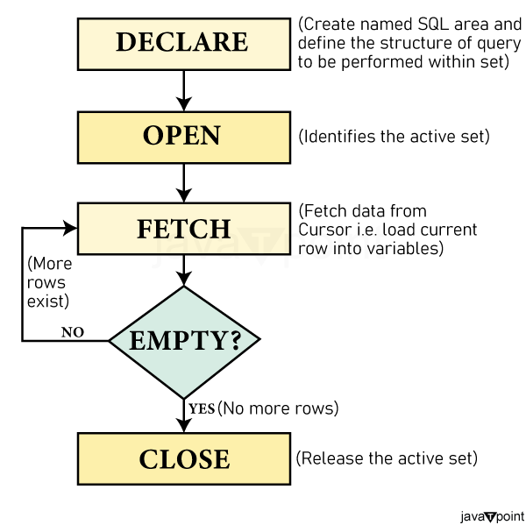
2) PL/SQL Explicit Cursors
The Explicit cursors are defined by the programmers to gain more control over the context area. These cursors should be defined in the declaration section of the PL/SQL block. It is created on a SELECT statement which returns more than one row.
Syntax of explicit cursor
CURSOR cursor_name IS select_statement;
You must follow these steps while working with an explicit cursor.

Slide 41
Declare the cursor to initialize in the memory.
Open the cursor to allocate memory.
Fetch the cursor to retrieve data.
Close the cursor to release allocated memory.
1) Declare the cursor:
It defines the cursor with a name and the associated SELECT statement. Every cursor must be declared before use in the declaration segment of the PL/SQL block. Declaring a cursor means giving it a name and specifying the SELECT statement with which the cursor is associated. At this time there is no memory allocation. Declaration segment of PL/SQL block may declare more than one cursors at a time but of different names.
Syntax
CURSOR name IS
SELECT statement;
2) Open the cursor:
It is used to allocate memory for the cursor and make it easy to fetch the rows returned by the SQL statements into it. After the declaration, the cursor is opened with OPEN statement to process the rows in the cursor.
While opening the cursor, the actual memory allocation to the cursor takes place which is crucial for processing information. The SELECT statement related with the cursor is parsed. It also locates the active data set i.e. rows of all included that are declared to the cursor and are created when the cursor is opened. When the OPEN statement is performed, rows are not retrieved from the active data set. Instead, the FETECH statement retrieves the rows. It also places a pointer just before the first row in the active set.
Syntax
OPEN cursor_name;

Slide 42
3) Fetch the cursor:
After the cursor is opened, the active data set is identified and the SELECT statement related with the cursor is executed. The FETCH statement retrieves one row at a time from the active data set. After performing each FETCH statement the cursor pointer moves to the next row in the active data set and retrieves it.
It is used to access one row at a time. You can fetch rows from the above-opened cursor as follows:
Syntax for cursor fetch:
FETCH cursor_name INTO variable_list;
In the above syntax, where cursor_name is the name of the cursor from which the records are retrieved and variable_list is the name of the variables to which the columns values are assigned. There must be a corresponding variable in the INTO test for each column name returned by the query related to cursors. The variables data type must match the corresponding database columns. The loop structures are used to retrieve records from the cursor into a variable one row at a time. The most commonly used Loop structure is the LOOP-END Loop. You can also fetch the record into a record structure with %ROWTYPE attribute.
4) Close the cursor:
After the rows in the cursor are processed, it is released with a CLOSE statement. The CLOSE statement closes the cursor and the active data set is not defined. It is used to free the already defined memory. Once the cursor is closed, you can reopen the cursor for further processing, possibly using a different parameter value to create a new active data set.
The following syntax is used to close a cursor that was opened above:
Syntax for cursor close:
Close cursor_name;

Slide 43
The PL/SQL Explicit Cursor attributes are used to retrieve information about the status of Explicit Cursor. The Explicit Cursor has the same set of attributes as that of implicit cursor attributes. These properties can be accessed in PL/SQL statements and not just SQL statements properties. You can reference these attributes by using the given syntax:
<cursorname> % <attributename>
In the above syntax, where cursorname is the name of the cursor you have entered.
The various Explicit Cursor attributes are:
<cursorname> %FOUND: Returns TRUE if the record was not successfully retrieved, otherwise FALSE.
<cursorname> %NOTFOUND: Returns TRUE if the records were successfully retrieved, otherwise FALSE.
<cursorname> %ROWCOUNT: Returns the number of records retrieved from the specified cursor at that time.
<cursorname> %ISOPEN: It returns FALSE if the specified cursor is not opened, otherwise returns TRUE.

Slide 44
SET SERVEROUTPUT ON;
DECLARE
CURSOR d_cursor IS
SELECT * from Dept;
D_Record Dept % ROWTYPE;
BEGIN
OPEN d_cursor;
LOOP
FETCH d_cursor INTO D_Record;
EXIT WHEN d_cursor%NOTFOUND;
DBMS_OUTPUT.PUT_LINE(D_Record.Dname || ' ' || D_Record.Loc);
END LOOP;
CLOSE d_cursor;
END;
/

