Slide 1
Types Of Artificial Intelligence

Slide 2
Types Of AI
Artificial Intelligence can be broadly classified into several types based on capabilities, functionalities, and technologies.
According to the capabilities of AI, they are classified into three categories, which are
Narrow AI, or Weak AI (ANI)
General AI, or Strong AI (AGI)
Artificial SuperIntelligence (ASI)

Slide 3
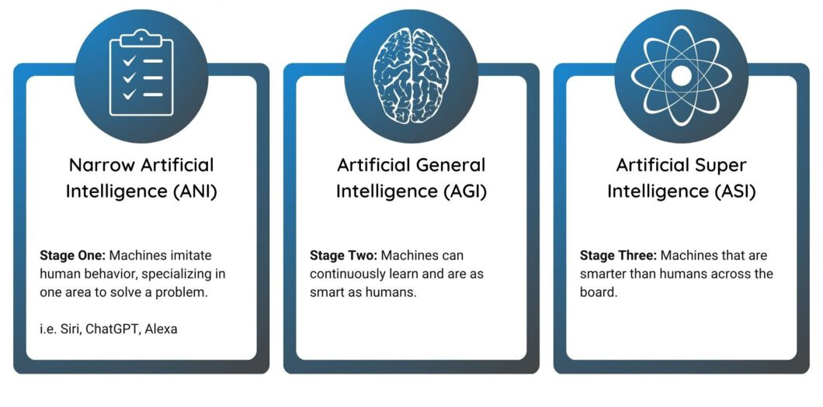

Slide 4
1. Narrow AI (Weak AI)
Designed to perform a narrow task based on given instructions.
Good at handling specific jobs like recognizing images, driving cars autonomously, speech recognition, language translation, playing games like chess etc.
Most common type of AI currently in use.
Handle routine tasks, however, they cannot perform tasks beyond their specialization.
Three examples of well-known ANI tools are Alexa, Siri, and ChatGPT.

Slide 5
2. General AI (Strong AI)
Also called Strong AI, takes the concept of learning a step further.
Tries to learn and think like human, not just follow instructions.
Machines can think and understand things like humans.
Computer can learn and solve complex problems just as humans do.
Machines understand human emotions, trust, and thought processes rather than just following them.
Examples: As of now, there are no true examples of AGI, but researchers are actively exploring ways to develop this level of intelligence.

Slide 6
3. Superintelligent AI
This is future form of AI where machines could overtake human intelligence across all fields, including creativity, general knowledge, and problem-solving.
This can give a challenge to humans in various areas due to their limitless intelligence.
Solve hard problems and learn way faster than we do.
Some experts are concerned about ASI. They worry that once it’s created, it might be tough to control.
However, if managed properly, ASI could be highly useful.
It might be very helpful in other technology sectors, space research, medicine, and more.

Slide 7
Differences between ANI, AGI, and ASI:
ANI is mainly used to perform specific jobs without learning beyond what it’s meant for.
AGI is like human intelligence and can do many things at once.
ASI is smarter than the human mind and can perform any task better.

Slide 8
Introduction To Machine Learning

Slide 9
Machine Learning (ML)
Branch of artificial intelligence (AI)
Allows computers to learn and make predictions or decisions without being explicitly programmed for each task.
Use data to understand patterns, make predictions, and improve performance.
Enables computers to automatically improve their performance on a task through experience.
Just like humans learn from their experiences, machines learn from the data provided to them.

Slide 10
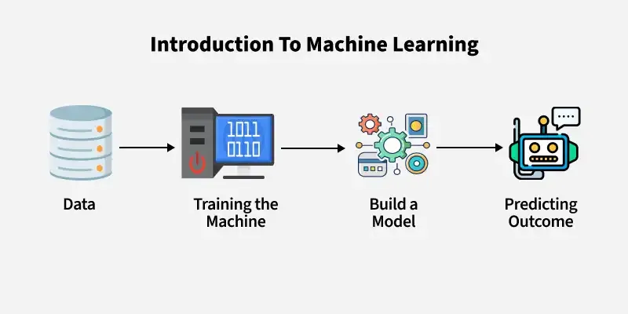

Slide 11
Types Of Machine Learning
There are three main types of machine learning:
1. Supervised Learning
2. Unsupervised Learning
3. Reinforcement Learning

Slide 12
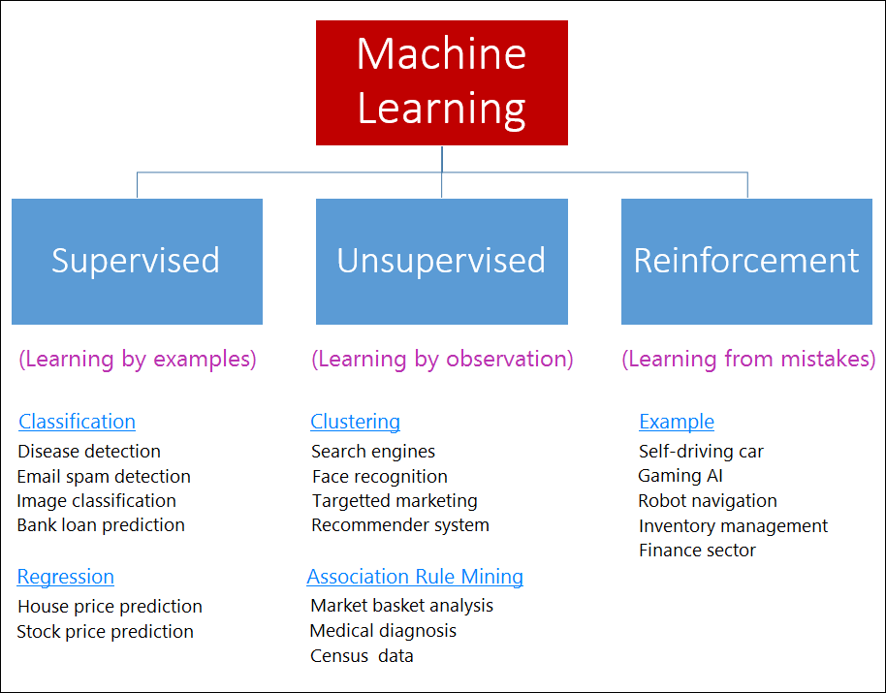

Slide 13
1.Supervised learning
In this ML, a model is trained on labeled data.
Meaning each input (the data) has a corresponding output (the label).
The model learns the relationship between inputs and outputs and then predict outputs.

Slide 14
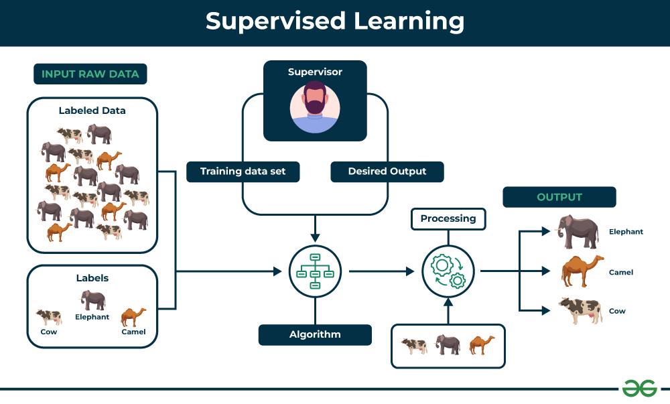

Slide 15
2 Unsupervised learning
In Unsupervised Learning, the data does not have labels.
The model is given only the inputs.
There is no predefined categories or classifications in the data.
They find patterns or groupings on their own.

Slide 16
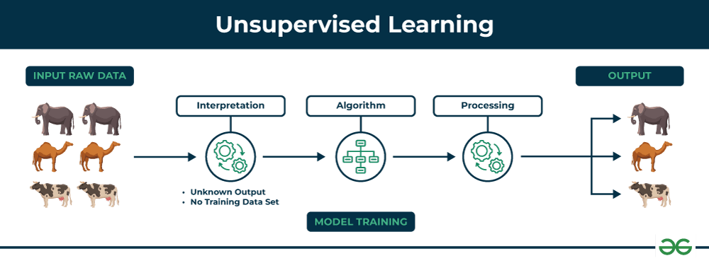

Slide 17
3 Reinforcement Learning (RL)
RL involves an agent (a model) that learns through trial and errors.
Unlike other machine learning types, RL doesn’t provide any instructions.
Instead, the agent learns by:
      Trying different actions.
      Receiving Feedback.
      Improving Performance.

Slide 18
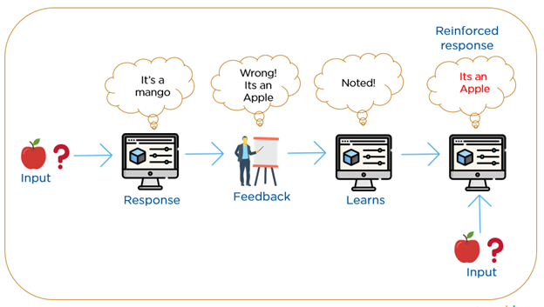

Slide 19
Thank You!!

